Slide 1
Panel 4 – Managing Data Protection and Cybersecurity in Healthcare
GDPR - the industry perspective
Olivier JOFFRAY
COCIR Lead member in Digital Health and Head of GDPR compliance at IDEMIA

Slide 2
Internal organization
Data Protection Office (DPO)
Process definition and deployment
Training
Analysis of products and contracts and prioritization

Slide 3
Towards our customers
Product level
Solution level
Service level
  Delivering Confidence By Design
  Supporting end-to-end Security & Privacy

Slide 4
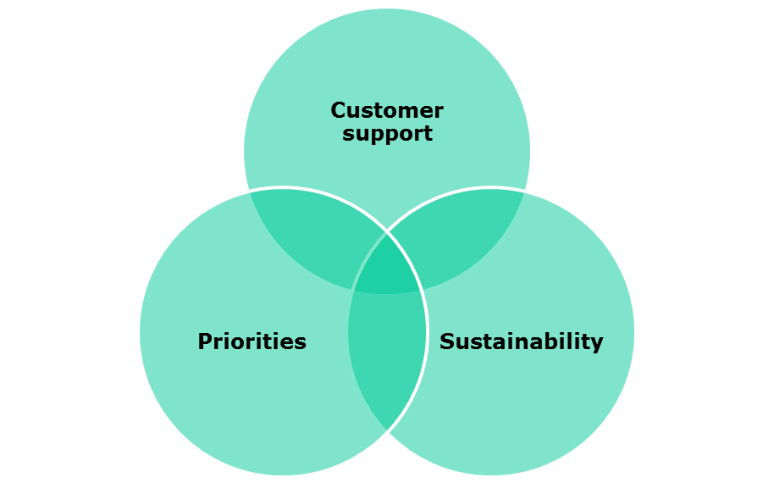
Top challenges
Win-Win vs efforts
Limited control on processes: Consent / Proof management?
Which contract and product to manage first?
Privacy by Design
Security components
Cost impact
Capitalization
Security components

Slide 5
Thank you for your attention!
www.cocir.org

